Slide 1
Blood Donation Management System

Slide 2

🩸 Abstract – Blood Donation Management System
The Blood Donation Management System is designed to manage blood donation records in an organized way. It stores details of donors, hospitals, blood banks, donations, and recipients in a connected database. This system makes it easier to manage and access information while maintaining accurate relationships between different records.

Slide 3
🎯 Objectives
🧑‍🤝‍🧑 Manage Donors
• Maintain donor details and blood groups.
🏥 Manage Hospitals
• Store and organize hospital information.
🩸 Track Donations
• Record donation dates, donors, and blood quantities.
❤️ Manage Recipients
• Track recipient details and required blood groups.
🔗 Maintain Relationships
• Connect donors, hospitals, blood banks, donations, and recipients using primary and foreign keys.
🔍 Easy Data Retrieval
• Use SQL queries, JOINs, and subqueries to access related information efficiently.

Slide 4
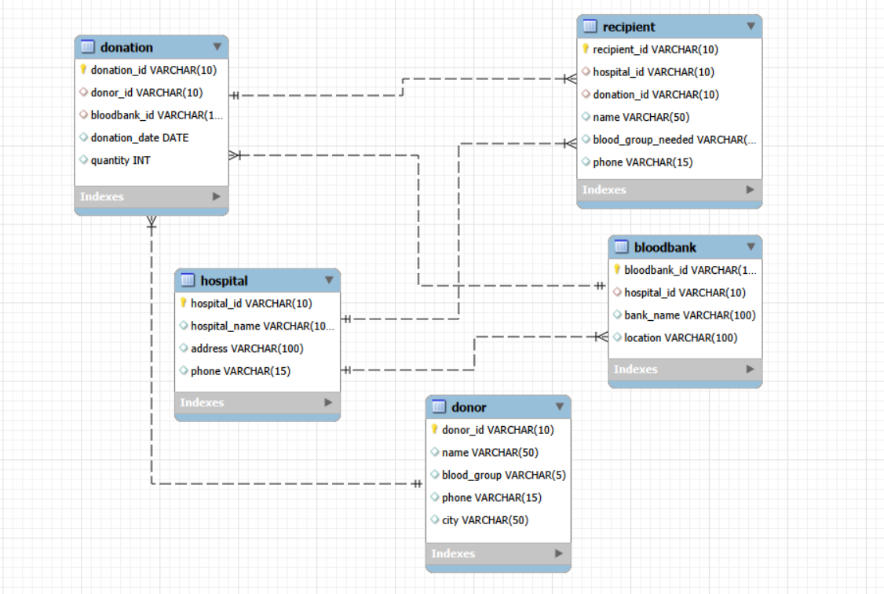
🩸 Entity Relationship Diagram

Slide 5
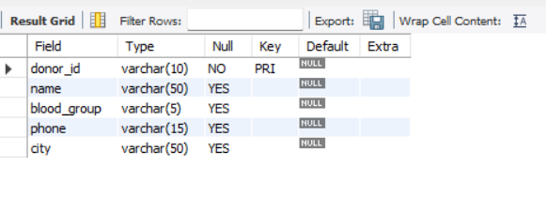
Structure Of Table — Donor
This table stores the personal information of blood donors. It contains the donor ID, donor name, blood group, phone number, and city.
Syntax:
DESC Donor;

Slide 6
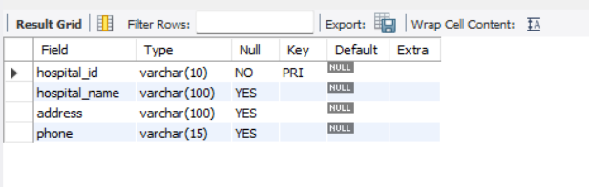
Structure Of Table — Hospital
This table stores information about hospitals. It contains the hospital ID, hospital name, address, and phone number.
Syntax:
DESC Hospital;

Slide 7
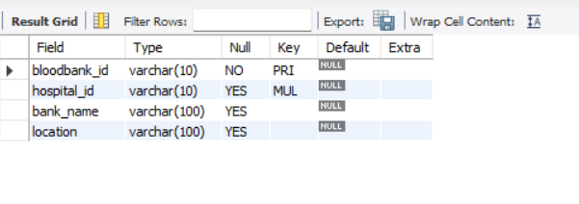
Structure Of Table: Bloodbank
This table stores information about blood banks associated with hospitals. It contains the blood bank ID, hospital ID, bank name, and location.
Syntax:
DESC BloodBank;

Slide 8
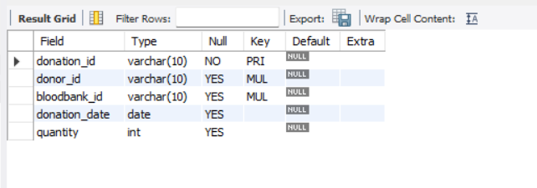
Structure Of Table: Donation
This table stores information about blood donations. It contains the donation ID, donor ID, blood bank ID, donation date, and quantity of blood donated.
Syntax:
DESC Donation;

Slide 9
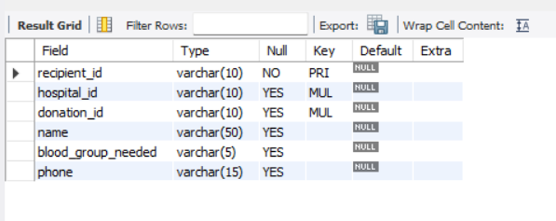
Structure Of Table: Recipient
This table stores information about recipients who require blood. It contains the recipient ID, hospital ID, donation ID, recipient name, required blood group, and phone number.
Syntax:
DESC Recipient;

Slide 10
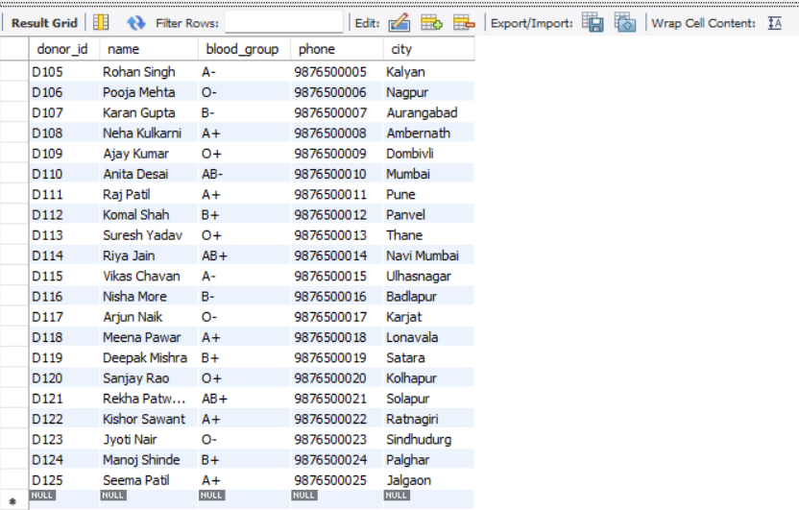
Contents of Donor Table
Syntax:-
SELECT * FROM Donor;

Slide 11
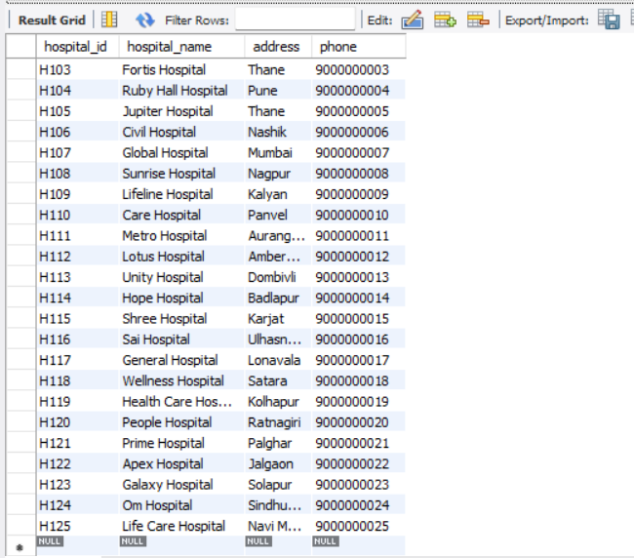
Contents of Hospital Table
Syntax:-
SELECT * FROM Hospital ;

Slide 12
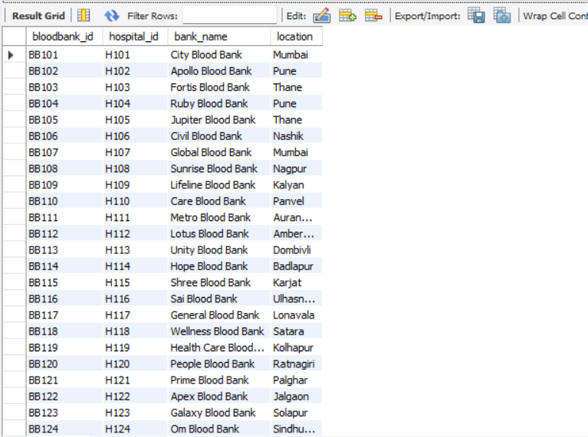
Contents of BloodBank Table
Syntax:-
SELECT * FROM BloodBank ;

Slide 13
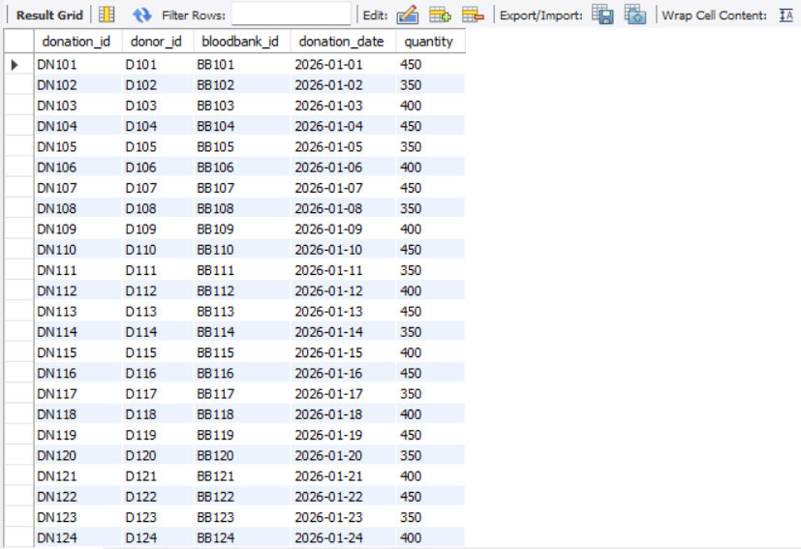
Contents of Donation Table
Syntax:-
SELECT * FROM Donation ;

Slide 14
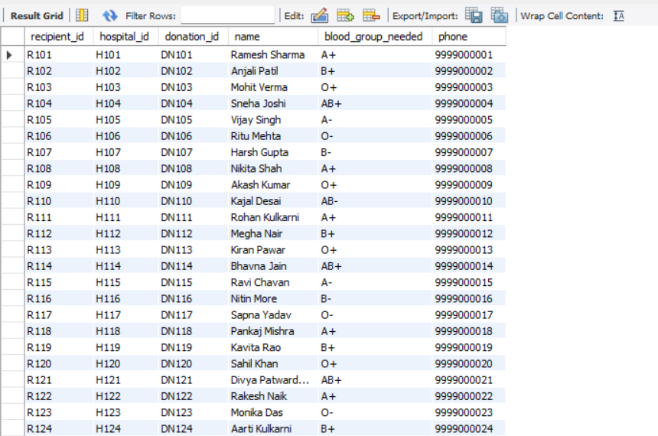
Contents of Recipient Table
Syntax:-
SELECT * FROM Recipient ;

Slide 15
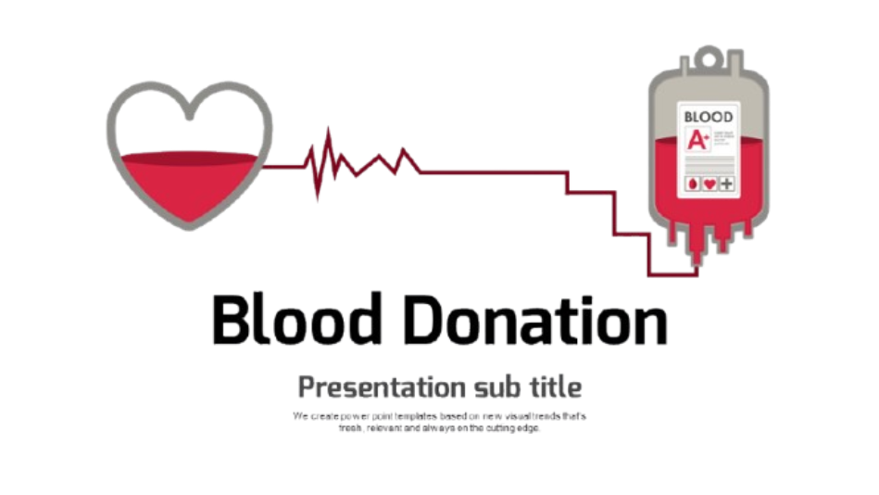
Blood Donation Joins

Slide 16
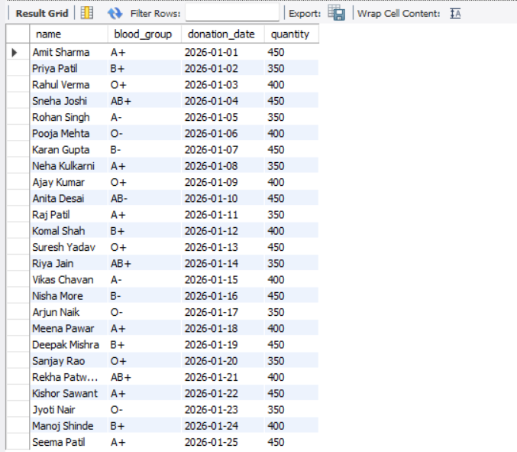
Joins
Q1. Display donor name and donation details.
Syntax
Select d.name, d.blood_group,
dn.donation_date, dn.quantity
From Donor d
Inner join Donation dn
on d.donor_id = dn.donor_id;

Slide 17
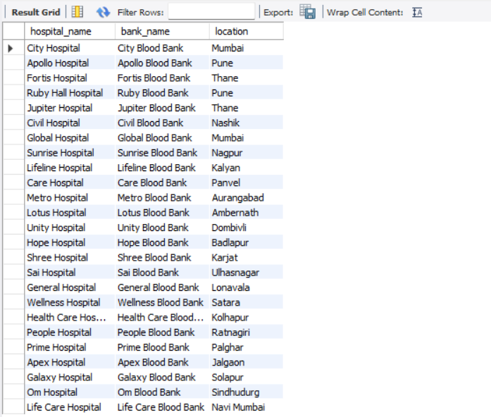
Joins
Q2. Display hospital and blood bank details
Syntax
Select h.hospital_name, b.bank_name, b.location
From Hospital h
inner join BloodBank b
On h.hospital_id = b.hospital_id;

Slide 18
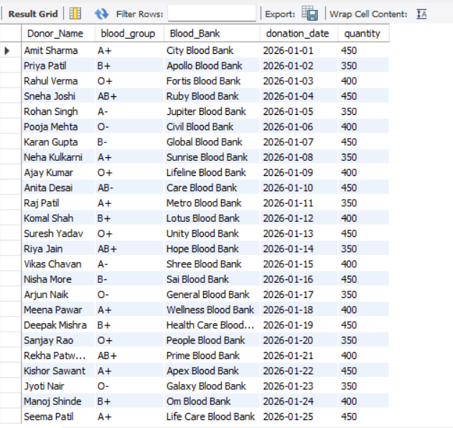
Joins
Q3. Display donor and blood bank details
Syntax
Select d.name as Donor_Name, d.blood_group, b.bank_name as
Blood_Bank, dn.donation_date, dn.quantity
From Donor d
inner join Donation dn
on d.donor_id = dn.donor_id
inner join bloodbank b
on dn.bloodbank_id = b.bloodbank_id;

Slide 19
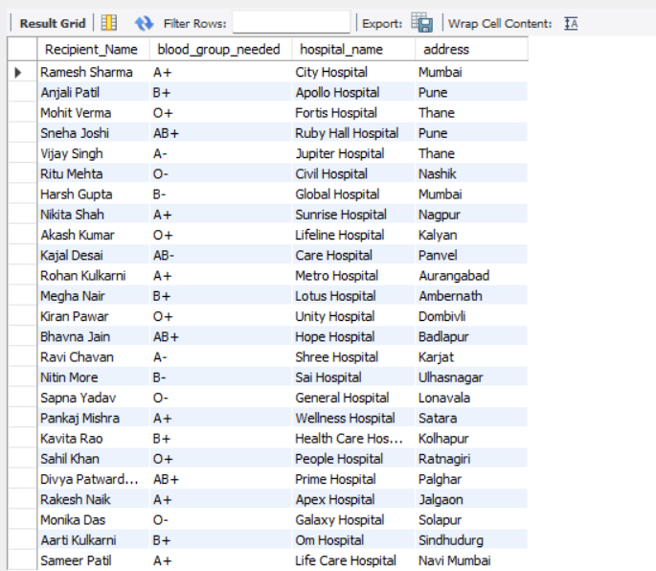
Joins
Q4. Display recipient and hospital details
Syntax
Select r.name as Recipient_Name, r.blood_group_needed,
h.hospital_name, h.address
from Recipient r
inner join Hospital h
on r.hospital_id = h.hospital_id;

Slide 20
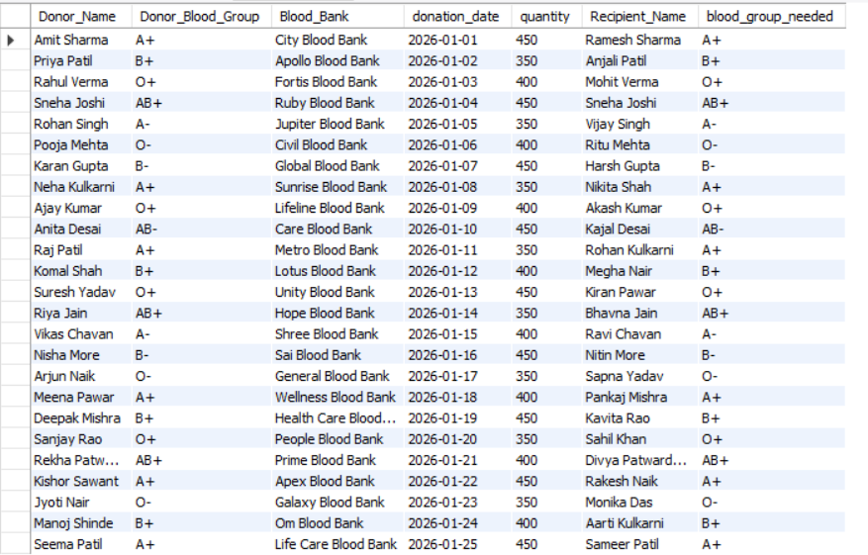
Joins
Q5. Display complete blood donation information
Syntax
SELECT d.name as Donor_Name, d.blood_group as Donor_Blood_Group, b.bank_name as Blood_Bank, dn.donation_date, dn.quantity, r.name as Recipient_Name, r.blood_group_needed
from Donor d
inner join Donation dn
on d.donor_id = dn.donor_id
inner join BloodBank b
on dn.bloodbank_id = b.bloodbank_id
inner join Recipient r
on dn.donation_id = r.donation_id;

Slide 21
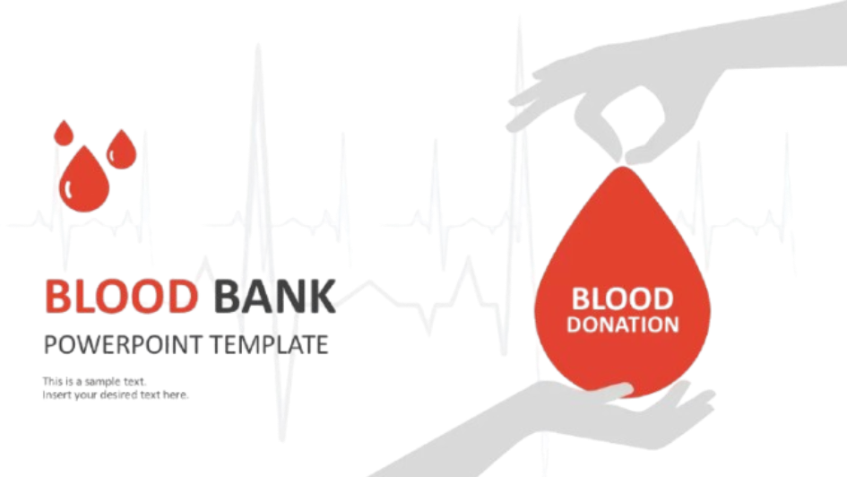
Blood Donation Sub Queries

Slide 22
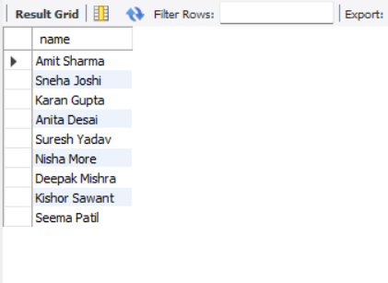
Sub query
Q1. Find the donor who donated the maximum quantity of blood
Syntax
select name from donor where donor_id in (
select donor_id from donation where quantity = (
select max(quantity) from donation ) );

Slide 23
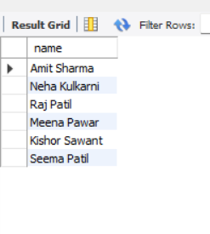
Sub query
Q2. Display donors with blood group A+
Syntax
select name from donor where donor_id in (
select donor_id from donation )
and blood_group = 'A+';

Slide 24
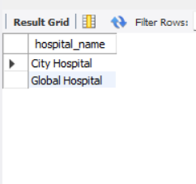
Sub query
Q3. Find hospitals that have blood banks in Mumbai
Syntax
select hospital_name from hospital
where hospital_id IN (
select hospital_id from BloodBank
where location = 'Mumbai’ );

Slide 25
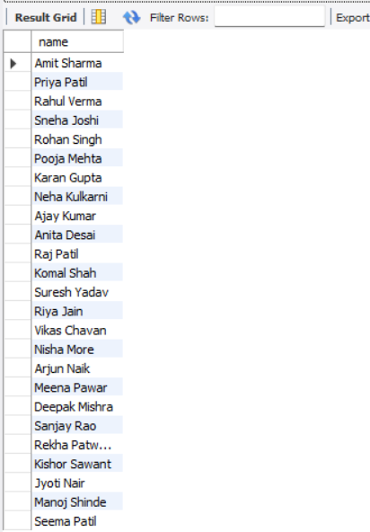
Sub query
Q4. Find donors who have donated blood
Syntax
select name from donor
where donor_id in (
select donor_id from donation );

Slide 26
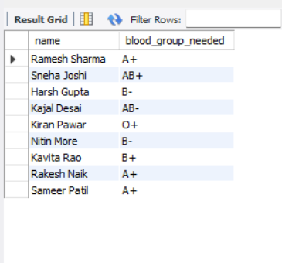
Sub query
Q5. Find recipients who received blood from donations greater than 400 ml
Syntax
select name, blood_group_needed
from recipient where donation_id in (
select donation_id from donation
where quantity > 400 );

Slide 27

Blood Donation Views

Slide 28
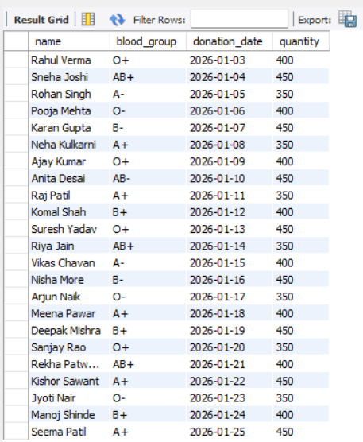
Views
Q1. Create a View to Display Donor Donation Details
Syntax
create view donordonationview as
select d.name, d.blood_group,
dn.donation_date, dn.quantity
from donor d inner join donation dn
on d.donor_id = dn.donor_id;
select * from donordonationview ;

Slide 29
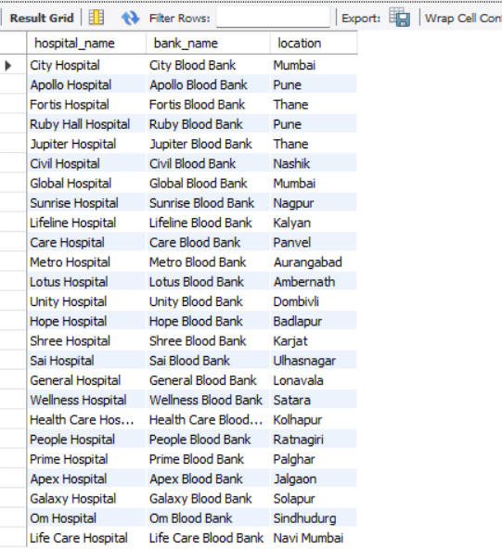
Views
Q2. Create a View to Display Hospital and Blood Bank Details
Syntax
create view hospitalbloodbankview as
select h.hospital_name, b.bank_name,
b.location from hospital h
inner join bloodbank b
on h.hospital_id = b.hospital_id;
select * from hospitalbloodbankview;

Slide 30
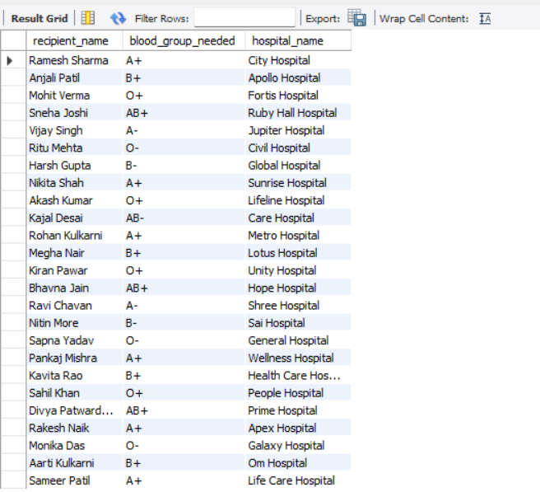
Views
Q2. Create a View to Display Recipient and Hospital Details
Syntax
create view recipienthospitalview as
select r.name as recipient_name,
r.blood_group_needed, h.hospital_name
from recipient r inner join hospital h
on r.hospital_id = h.hospital_id;
select * from recipienthospitalview;

Slide 31


